Slide 1
CSIK
netværksanalyse
Wireshark

Slide 2
Agenda
Intro og genopfriskning
Wireshark kort intro
Lab opsætnng
Gruppe arbejde omkring lab/wireshark
Opgaver

Slide 3
Hvorfor? (hvad siger studieordningen)
Den studerende har:
forståelse for praksis og anvendt teori og metode inden for netværksanalyse og kan reflektere over forskellige sikkerhedsudfordringer i netværk
Den studerende kan:
anvende metoder og redskaber til netværksanalyse og mestre opsætning, fejlfinding og tiltag til sikring af mindre netværk
Den studerende kan:
håndtere komplekse og udviklingsorienterede situationer i forbindelse med analyse af netværkstrafik med henblik på at forebygge eller afbøde angreb

Slide 4
Lidt genopfriskning

Slide 5
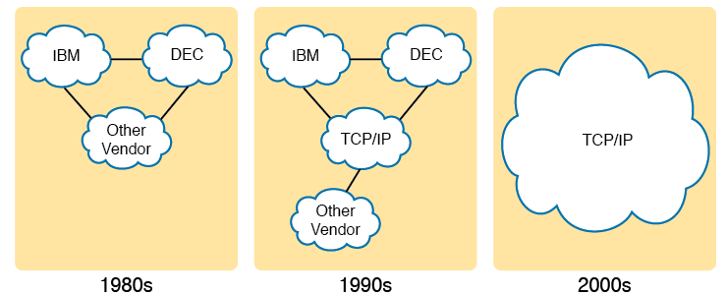
TCP/IP Networking Model
Historical Progression: Proprietary Models to Open TCP/IP

Slide 6
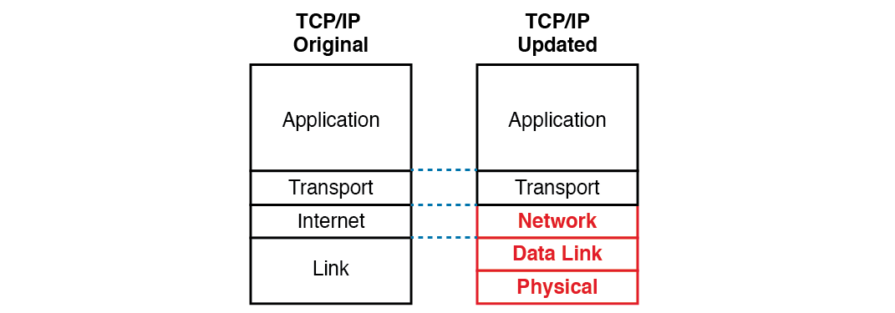
The Two TCP/IP Networking Models

Slide 7
TCP/IP Architectural Model and Example Protocols
TCP/IP Architecture Layer | Example Protocols
Application | HTTP, POP 3, SMTP
Transport | TCP,UDP
Internet | IP, ICMP
Data Link & Physical | Ethernet, 802.11 (Wi-Fi) TCP/IP

Slide 8
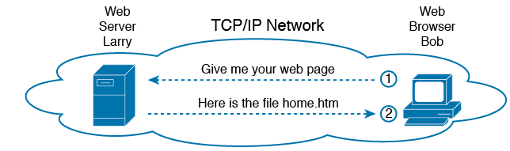
HTTP
Basic Application Logic to Get a Web Page

Slide 9
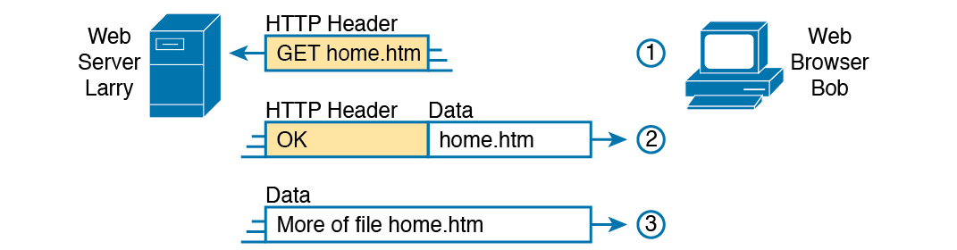
HTTP (continued)
HTTP Get Request, HTTP Reply, and one Data-Only Message

Slide 10
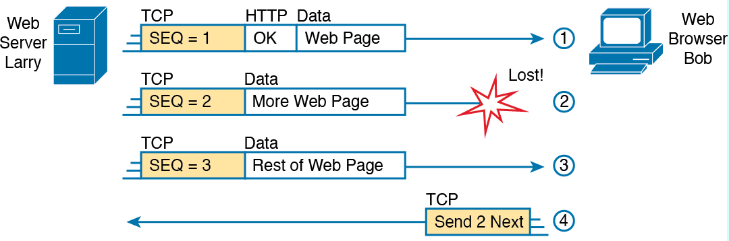
TCP/IP Transport Layer
TCP Error-Recovery Services as Provided to HTTP

Slide 11
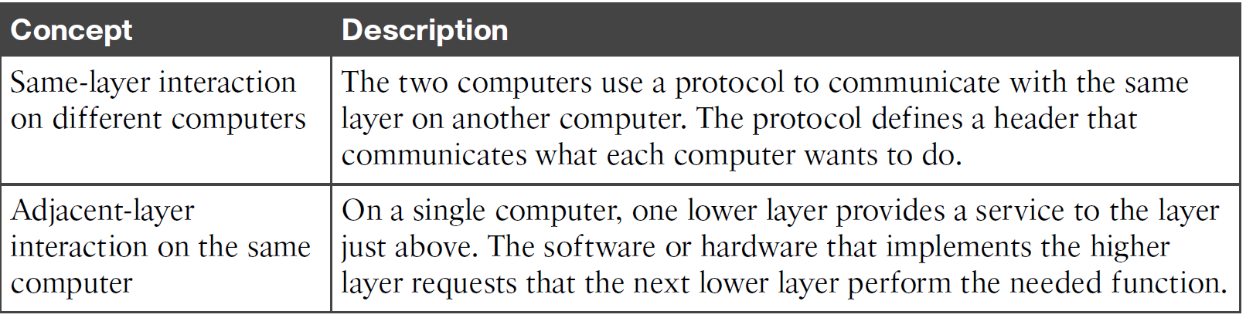
Same-Layer and Adjacent-Layer Interaction

Slide 12
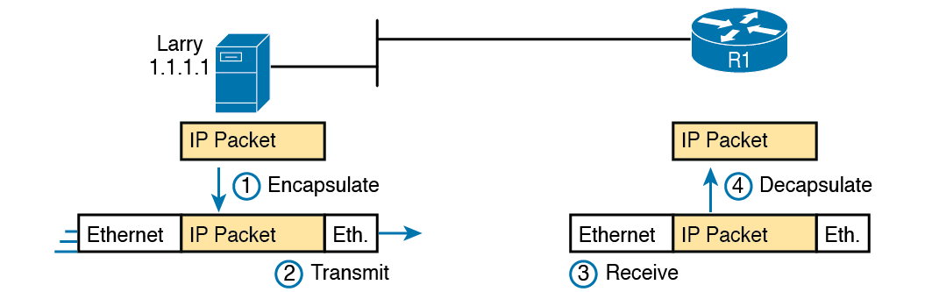
Ethernet
Larry Using Ethernet to Forward an IP Packet to Router R1

Slide 13
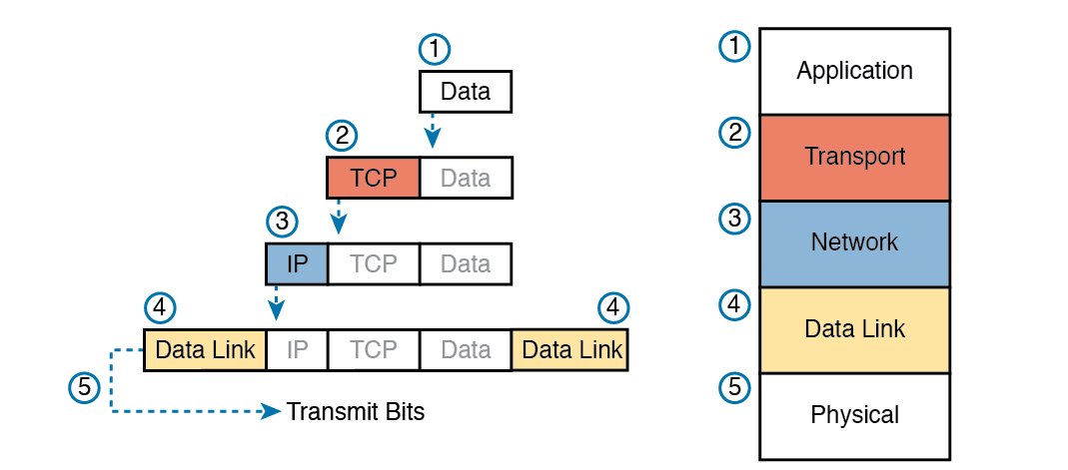
Five Steps of Data Encapsulation: TCP/IP

Slide 14

Perspective on Encapsulation and “Data”
The letters LH and LT stand for link header and link trailer, respectively, and refer to the data link layer header and trailer.
The letters LH and LT stand for link header and link trailer, respectively, and refer to the data link layer header and trailer.
The letters LH and LT stand for link header and link trailer, respectively, and refer to the data link layer header and trailer.

Slide 15
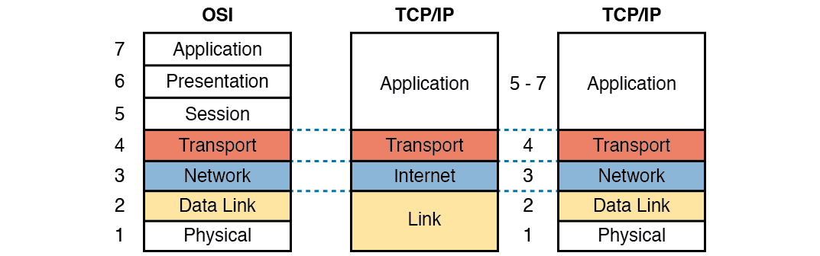
OSI Networking Model
OSI Model Compared to the Two TCP/IP Models

Slide 16
OSI Reference Model Layer Definitions
Layer | Functional Description
7 All | Application layer. This layer provides an interface between the communications software and any applications that need to communicate outside the computer on which the application resides. It also defines processes for user authentication.
6 People | Presentation layer. This layer’s main purpose is to define and negotiate data formats, such as ASCII text, EBCDIC text, binary, BCD, and JPEG. Encryption is also defined by OSI as a presentation layer service
5 Seem | Session layer. This layer defines how to start, control, and end conversations (called sessions). This includes the control and management of multiple bidirectional messages so that the application can be notified if only some of a series of messages are completed. This allows the presentation layer to have a seamless view of an incoming stream of data.
4 To | Transport layer. This layer’s protocols provide a large number of services, as described in Chapter 5, “Fundamentals of TCP/IP Transport and Applications.” Although OSI Layers 5 through 7 focus on issues related to the application, Layer 4 focuses on issues related to data delivery to another computer (for instance, error recovery and flow control).

Slide 17
OSI Reference Model Layer Definitions (Continued
Layer | Functional Description
3 Need | Network layer. This layer defines three main features: logical addressing, routing (forwarding), and path determination. Routing defines how devices (typically routers) forward packets to their final destination. Logical addressing defines how each device can have an address that can be used by the routing process. Path determination refers to the work done by routing protocols to learn all possible routes, and choose the best route.
2 Data | Data link layer. This layer defines the rules that determine when a device can send data over a particular medium. Data link protocols also define the format of a header and trailer that allows devices attached to the medium to successfully send and receive data
1 Processing | Physical layer. This layer typically refers to standards from other organizations. These standards deal with the physical characteristics of the transmission medium, including connectors, pins, use of pins, electrical currents, encoding, light modulation, and the rules for how to activate and deactivate the use of the physical medium.

Slide 18
OSI Reference Model Example Devices and Protocols
Layer Name | Protocols and Specifications | Devices
Application, presentation, session (Layers 5–7) | Telnet, HTTP, FTP, SMTP, POP3, VoIP, SNMP | Hosts, firewalls
Transport (Layer 4) | TCP, UDP | Hosts, firewalls
Network (Layer 3) | IP | Router
Data link (Layer 2) | Ethernet (IEEE 802.3), HDLC | LAN switch, wireless access point, cable modem, DSL modem
Physical (Layer 1) | RJ-45, Ethernet (IEEE 802.3) | LAN hub, LAN repeater, cables

Slide 19
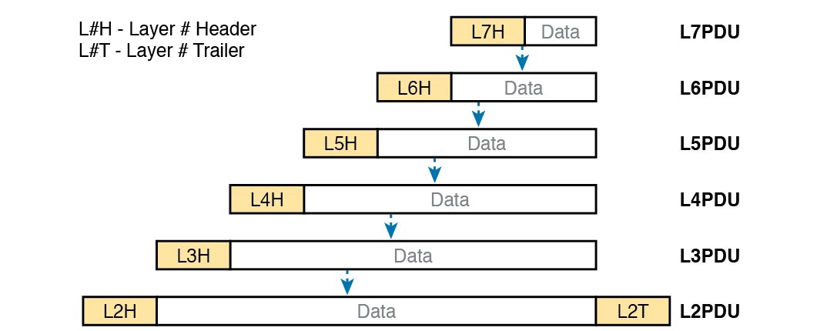
OSI Encapsulation and Protocol Data Units

Slide 20


Slide 21


Slide 22
Gruppedialog
Forklar for hinanden hvad I så i filmen.
Hvilke elementer lagde du særligt mærke til?
Var der noget som overraskende dig?
Hvad? (hvorfor)
Er denne video stadig gældende tror du/i?

Slide 23
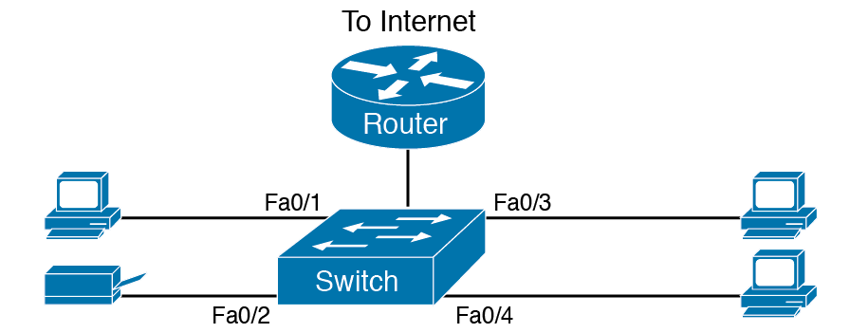
SOHO LAN

Slide 24
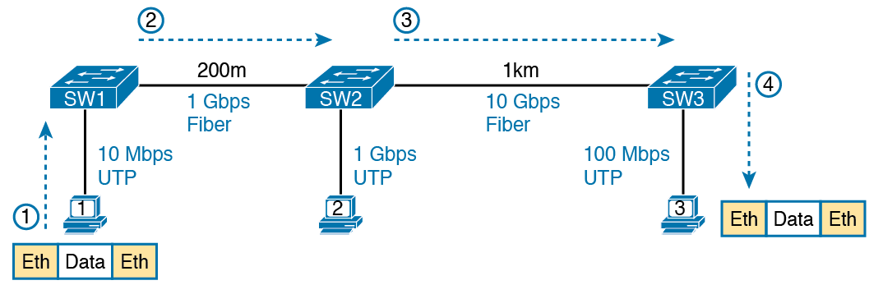
Ethernet LAN Forwards a Data Link Frame Over Many Types of Links

Slide 25
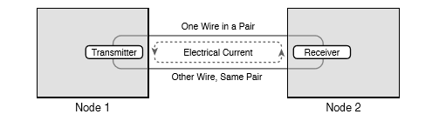
Creating One Electrical Circuit over One Pair to Send in One Direction

Slide 26
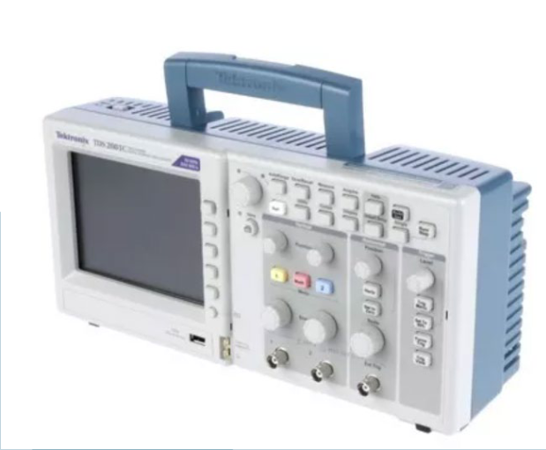
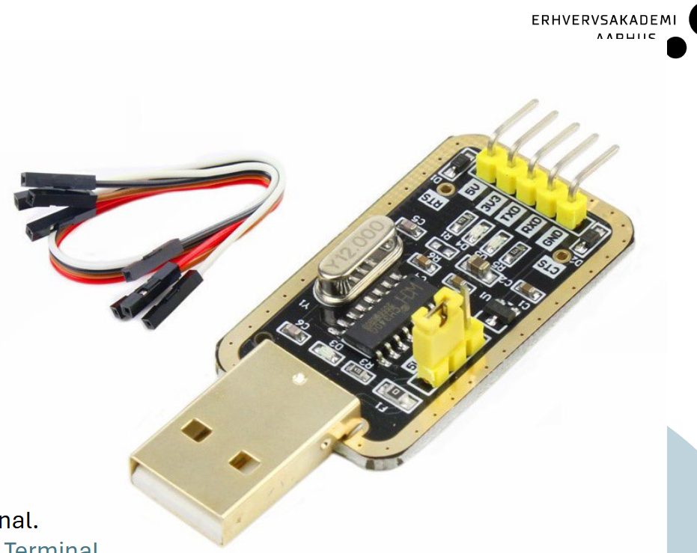
C-ark

Slide 27
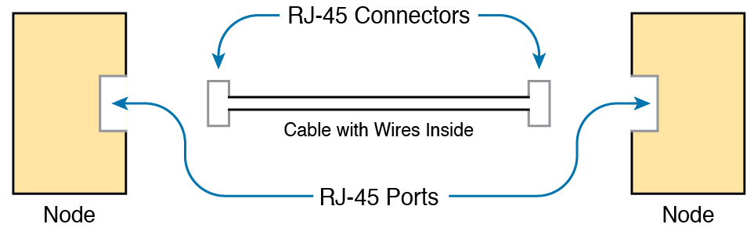
Basic Components of an Ethernet Link

Slide 28
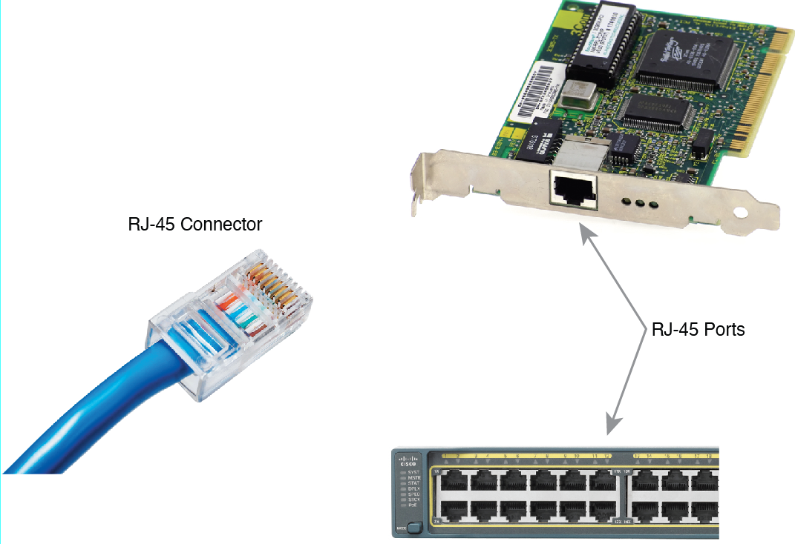
RJ-45 Connectors and Ports

Slide 29
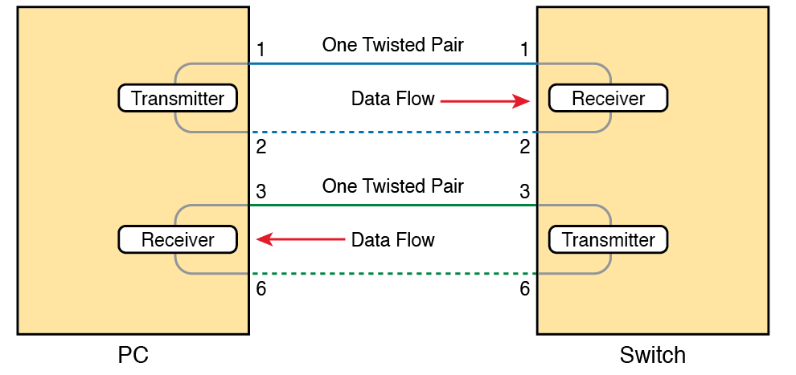
Using one Pair for Each Transmission Direction with 10- and 100-Mbps Ethernet

Slide 30
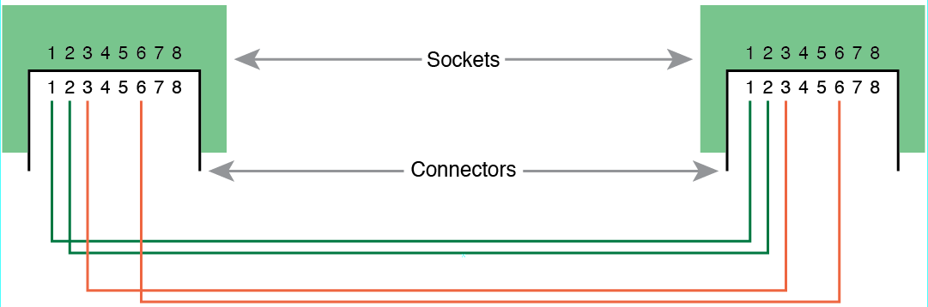
10Base-T and 100Base-T Straight-Through Cable Pinout

Slide 31
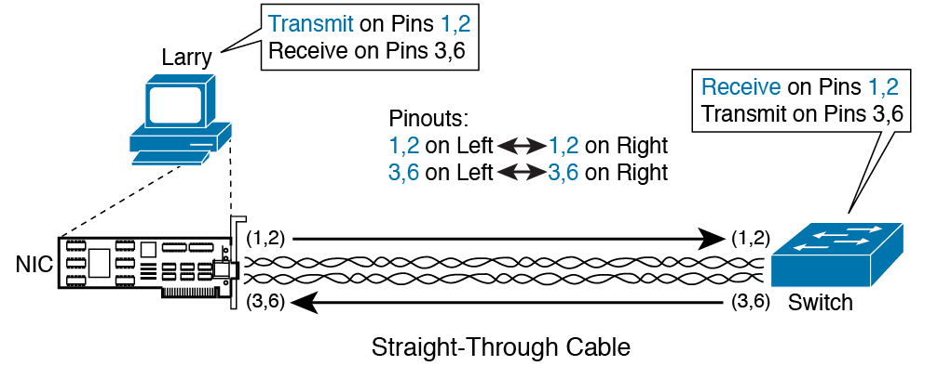
Ethernet Straight-Through Cable Concept

Slide 32
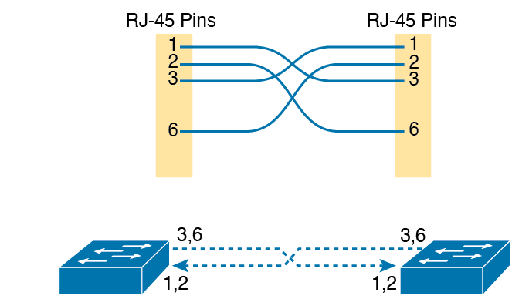
Crossover Ethernet Cable

Slide 33
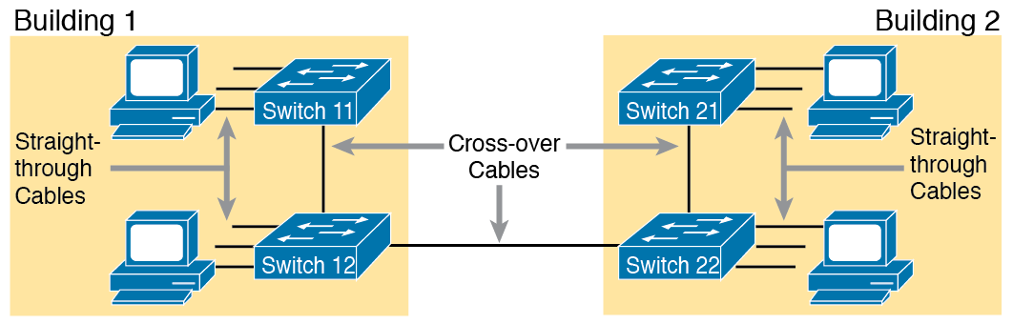
Typical Uses for Straight-Through and Crossover Ethernet Cables

Slide 34
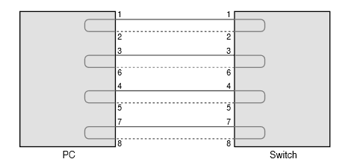
Four-Pair Straight-Through Cable to 1000BASE-T

Slide 35
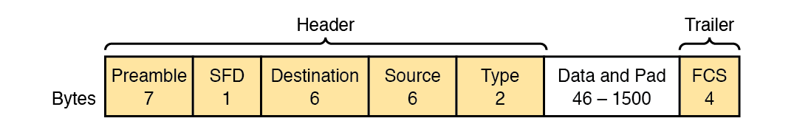
Commonly Used Ethernet Frame Format

Slide 36
IEEE 802.3 Ethernet Header and Trailer Fields
Field | Field Length in Bytes | Description
Preamble | 7 | Synchronization
Start Frame Delimiter (SFD) | 1 | Signifies that the next byte begins the Destination MAC Address field.
Destination MAC address | 6 | Identifies the intended recipient of this frame.
Source MAC address | 6 | Identifies the sender of this frame.
Type | 2 | Defines the type of protocol listed inside the frame; today, most likely identifies IP Version 4 (IPv4) or IP Version 6 (IPv6).
Data and Pad | 46-1500 | Holds data from a higher layer, typically an L3PDU (usually an IPv4 or IPv6 packet). The sender adds padding to meet the minimum length requirement for this field (46 bytes).
Frame Check Sequence (FCS) | 4 | Provides a method for the receiving NIC to determine if the frame experienced transmission errors

Slide 37
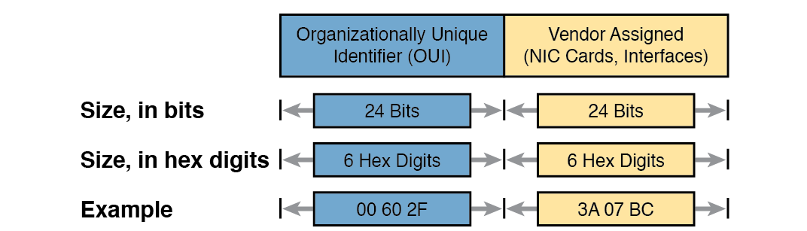
Structure of Unicast Ethernet Addresses

Slide 38
LAN MAC Address Terminology and Features
LAN Addressing Term or Feature | Description
MAC | Media Access Control. 802.3 (Ethernet) defines the MAC sublayer of IEEE Ethernet.
Ethernet address, NIC address, LAN address | Other names often used instead of MAC address. These terms describe the 6-byte address of the LAN interface card.
Burned-in address | The 6-byte address assigned by the vendor making the card.
Unicast address | A term for a MAC that represents a single LAN interface.
Broadcast address | An address that means “all devices that reside on this LAN right now.”
Multicast address | On Ethernet, a multicast address implies some subset of all devices currently on the Ethernet LAN.

Slide 39
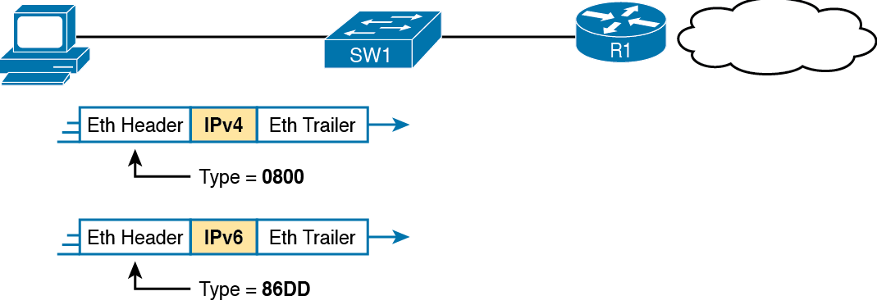
Use of Ethernet Type Field

